Slide 1

Determinants of NY State Gas Prices
Group Name: The X-Ponents
Group Members: Aaron Medley (Deadpool), Patrick Sicurello (Wolverine), Jennifer Zhuang (Psylocke)
Professor Z, Theory of Machine Learning 625.742
Fall 2024
Notes:
Introduction
Today, our group will be presenting our findings on a transportation fuels dataset
We sourced it from the New York Government Database (data.ny.gov).
The goal of our this presentation is to understand the structure of our dataset and its predictive potential
So in the comings weeks of this semester we can uncover meaningful insights through machine learning techniques.

Slide 2
Overview
Introduction
Data
Results & Analysis
Conclusions & Further Research
References
Notes:
Outline of our Presentation
Here is a brief outline of our presentation
I will begin with a brief exploratory data analysis (EDA) to give an overview of the dataset's key characteristics.
Patrick will dive deeper into the dataset’s background and present insights from the correlation matrix and scatterplots, helping us understand relationships between different variables.
Finally, Aaron will present a simple linear regression analysis we performed and discuss future steps for further refining our model and exploring additional predictive insights from the data.

Slide 3
Introduction
Goal: Understand the factors that effect gas prices in New York State and use these to predict future prices.
Understanding these drivers has implications for economic analysis, transportation policy, and understanding consumer behavior.
We will analyze data for multiple cities throughout NY State.
All data from data.ny.gov.

Slide 4
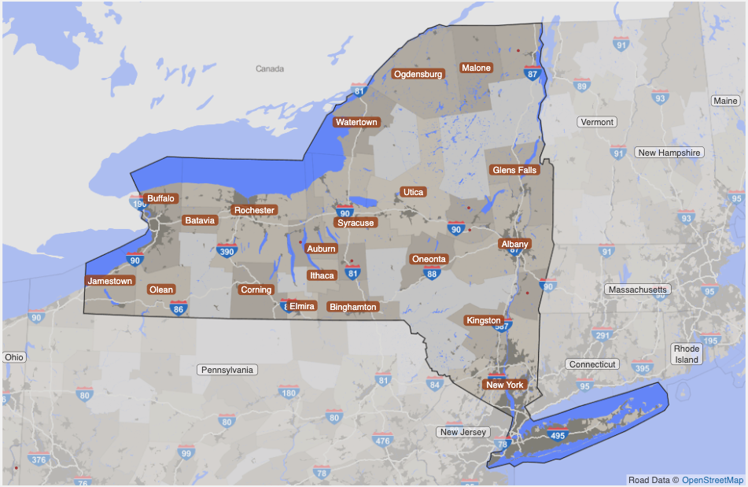
Data - Overview
NY Government Database (data.ny.gov).
Jan 2017 – September 2024
The dataset is indexed by date
402 rows, 51 features
Regional Data
Average gasoline prices ($/gal)
Average diesel prices ($/gal)
16 Regions: Albany, Batavia, Binghamton, Buffalo, Dutchess, Elmira, Glens Falls, Ithaca, Kingston, Nassau, NYC, Rochester, Syracuse, Utica, Watertown, White Plains

Slide 5
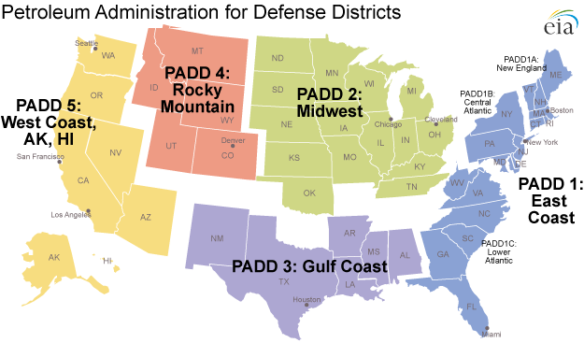
Data - Overview
Inventory Data (in Thousand Barrels)
Mid-Atlantic (PADD 1B)
ULS Diesel Stocks
Gasoline Stocks
East Coast (PADD 1)
Gasoline Stocks
Ethanol Stocks
Jet Fuels Stocks
United States
Gasoline Stocks
Crude Oil Stocks
ThePhoto by PhotoAuthor is licensed under CCYYSA.

Slide 6
Data - Overview
Production Data (in Thousand Barrels)
East Coast (PADD 1)
Production of Gasoline
Production of Jet Fuel
United States
Production of Gasoline
Production of Jet Fuel
Demand Data (in Thousand Barrels)
U.S. Gasoline Demand
ThePhoto by PhotoAuthor is licensed under CCYYSA.

Slide 7
Data - Overview
Spot Prices
NY Conventional Gasoline Spot Price ($/gal)
NY Ultra-Low Sulfur Diesel Spot Price ($/gal)
NY Jet Fuel Price ($/gal)
WTI Crude Oil Spot Price ($/barrel)
Brent Crude Oil Spot Price

Slide 8
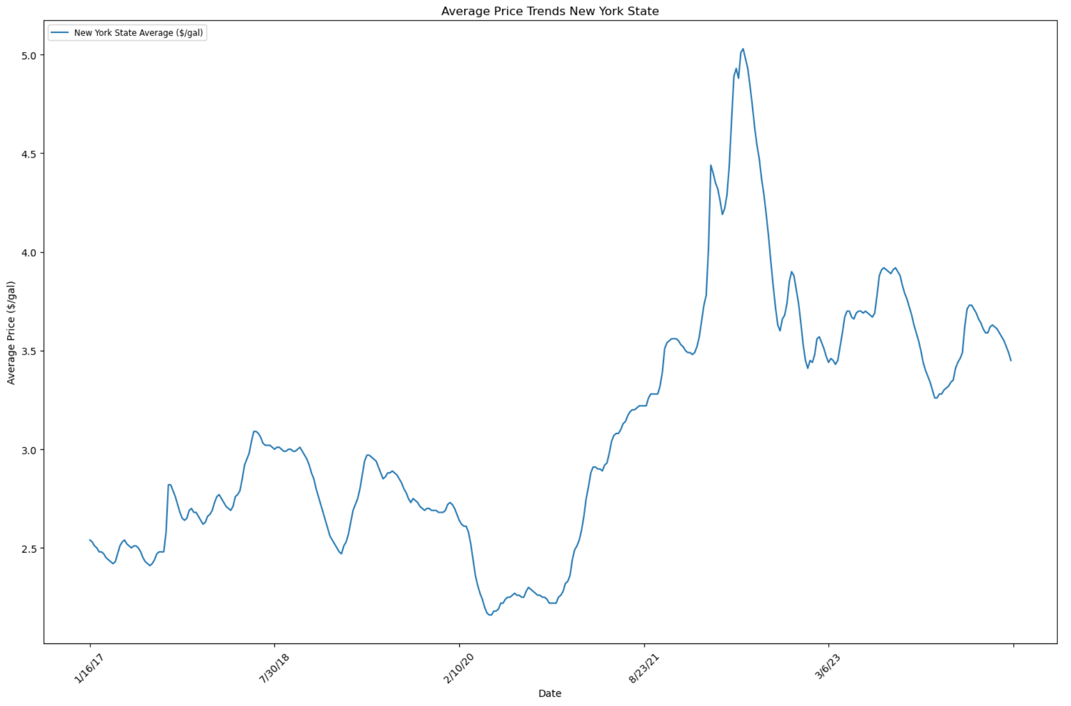
Data – Target Variable
Weekly average regular grade gasoline price for New York State ($/gal)
We aim to predict this value by using the data we discussed earlier to build a predictive model for fuel pricing

Slide 9
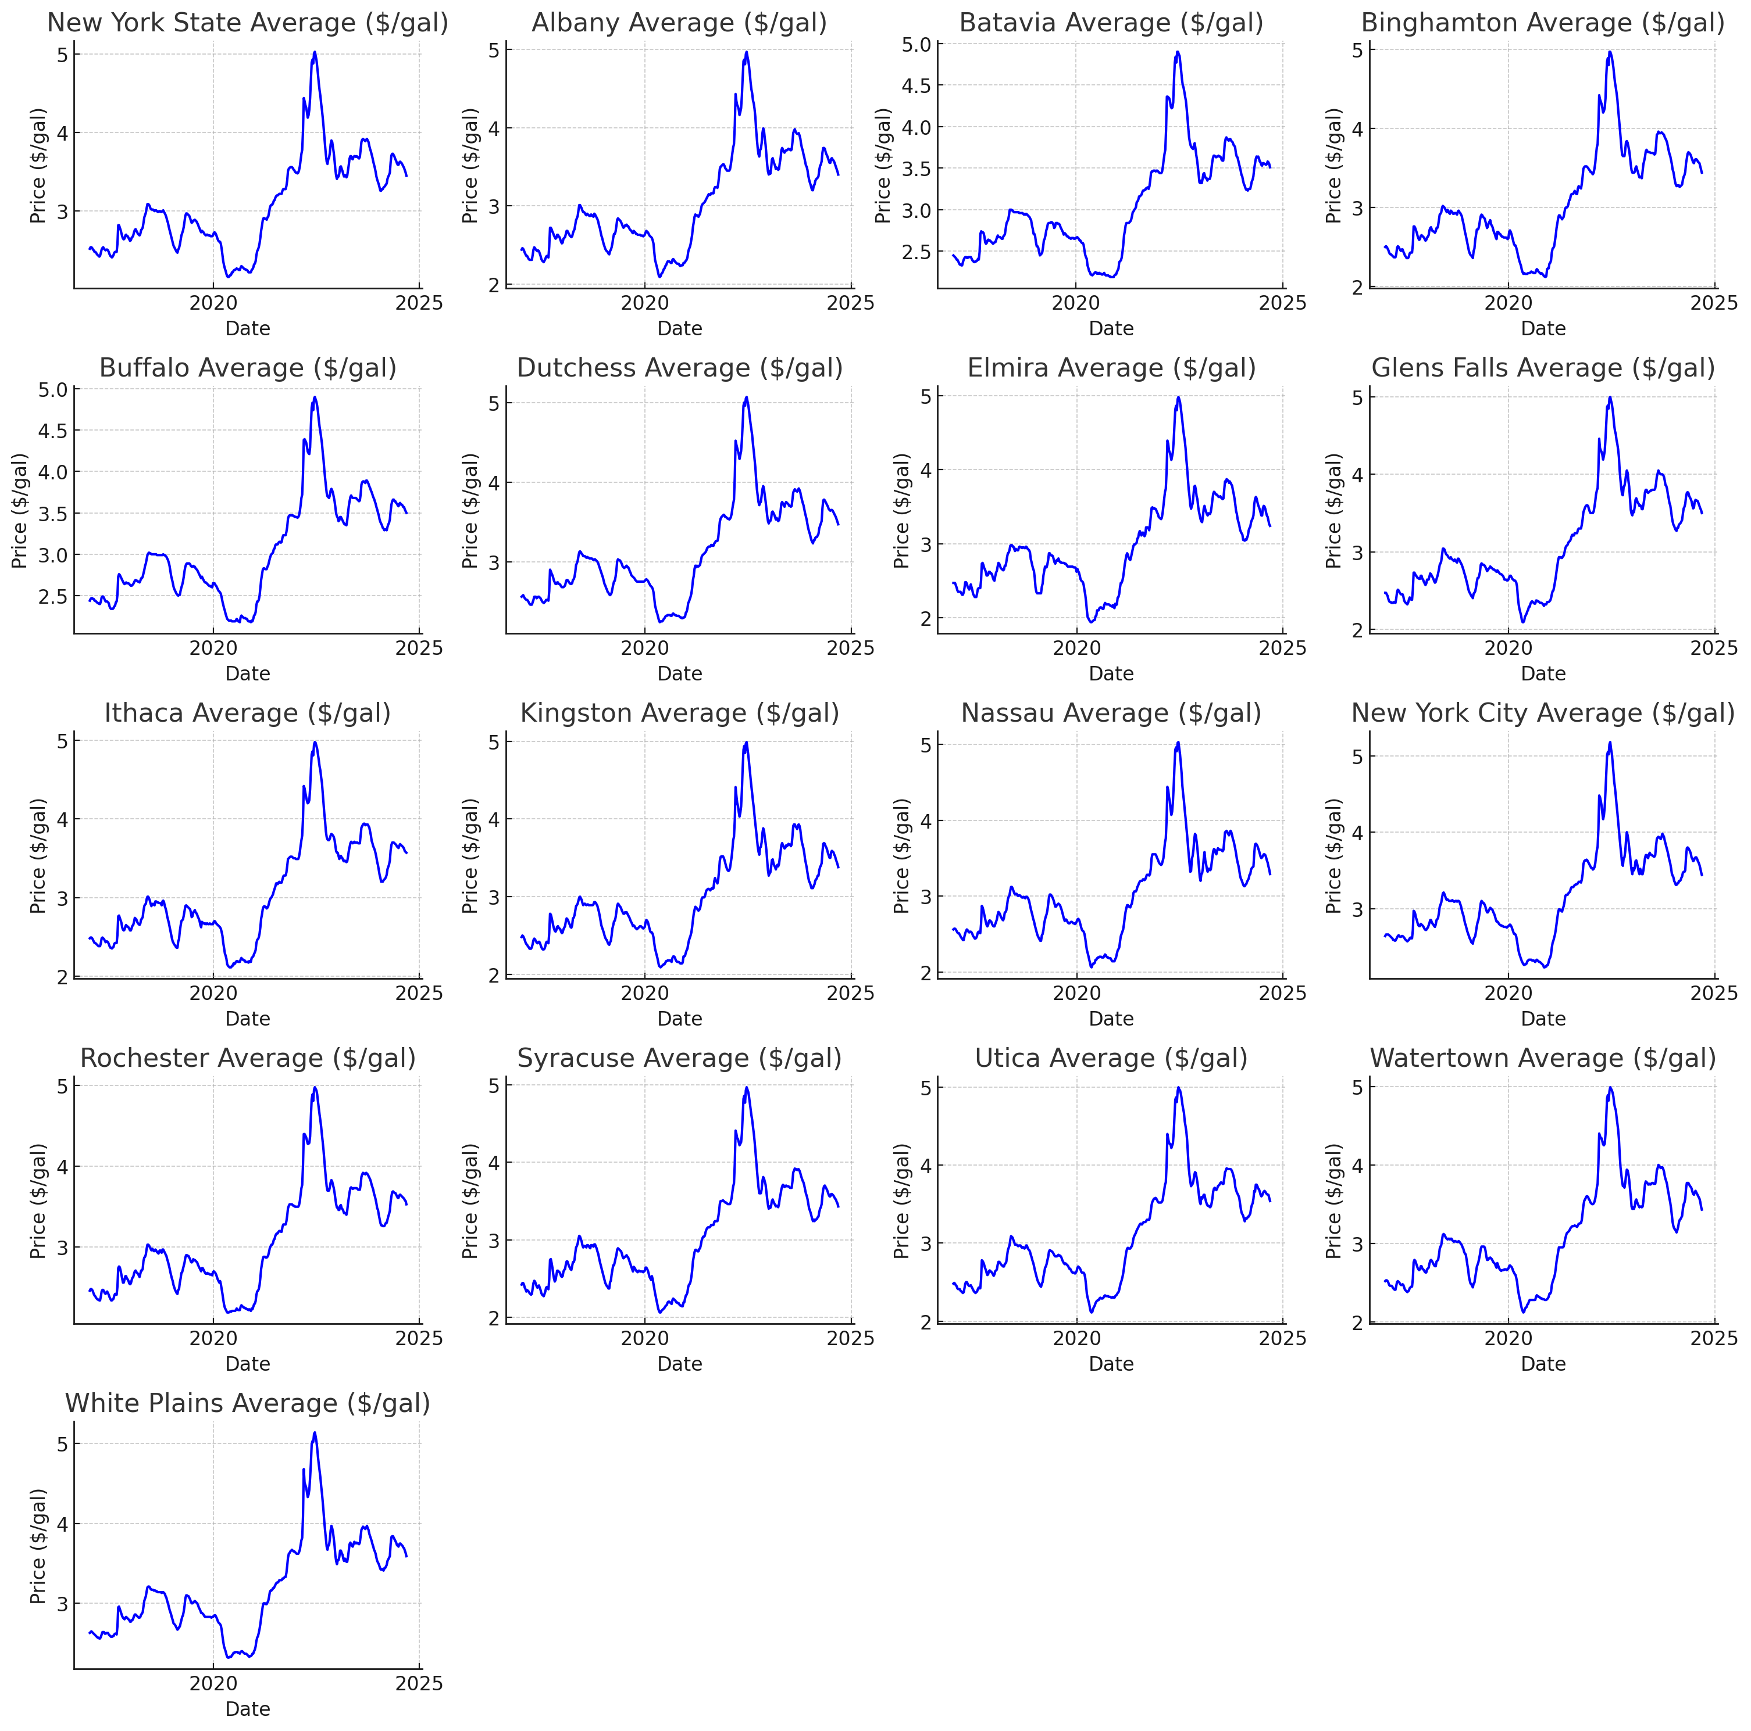
Data: NY Gas Prices
Series all appear to be highly correlated.
Linear regressions should likely avoid using these variables as features, since our response variable is NY State Average.
Could possibly lead to issues with multicollinearity.

Slide 10
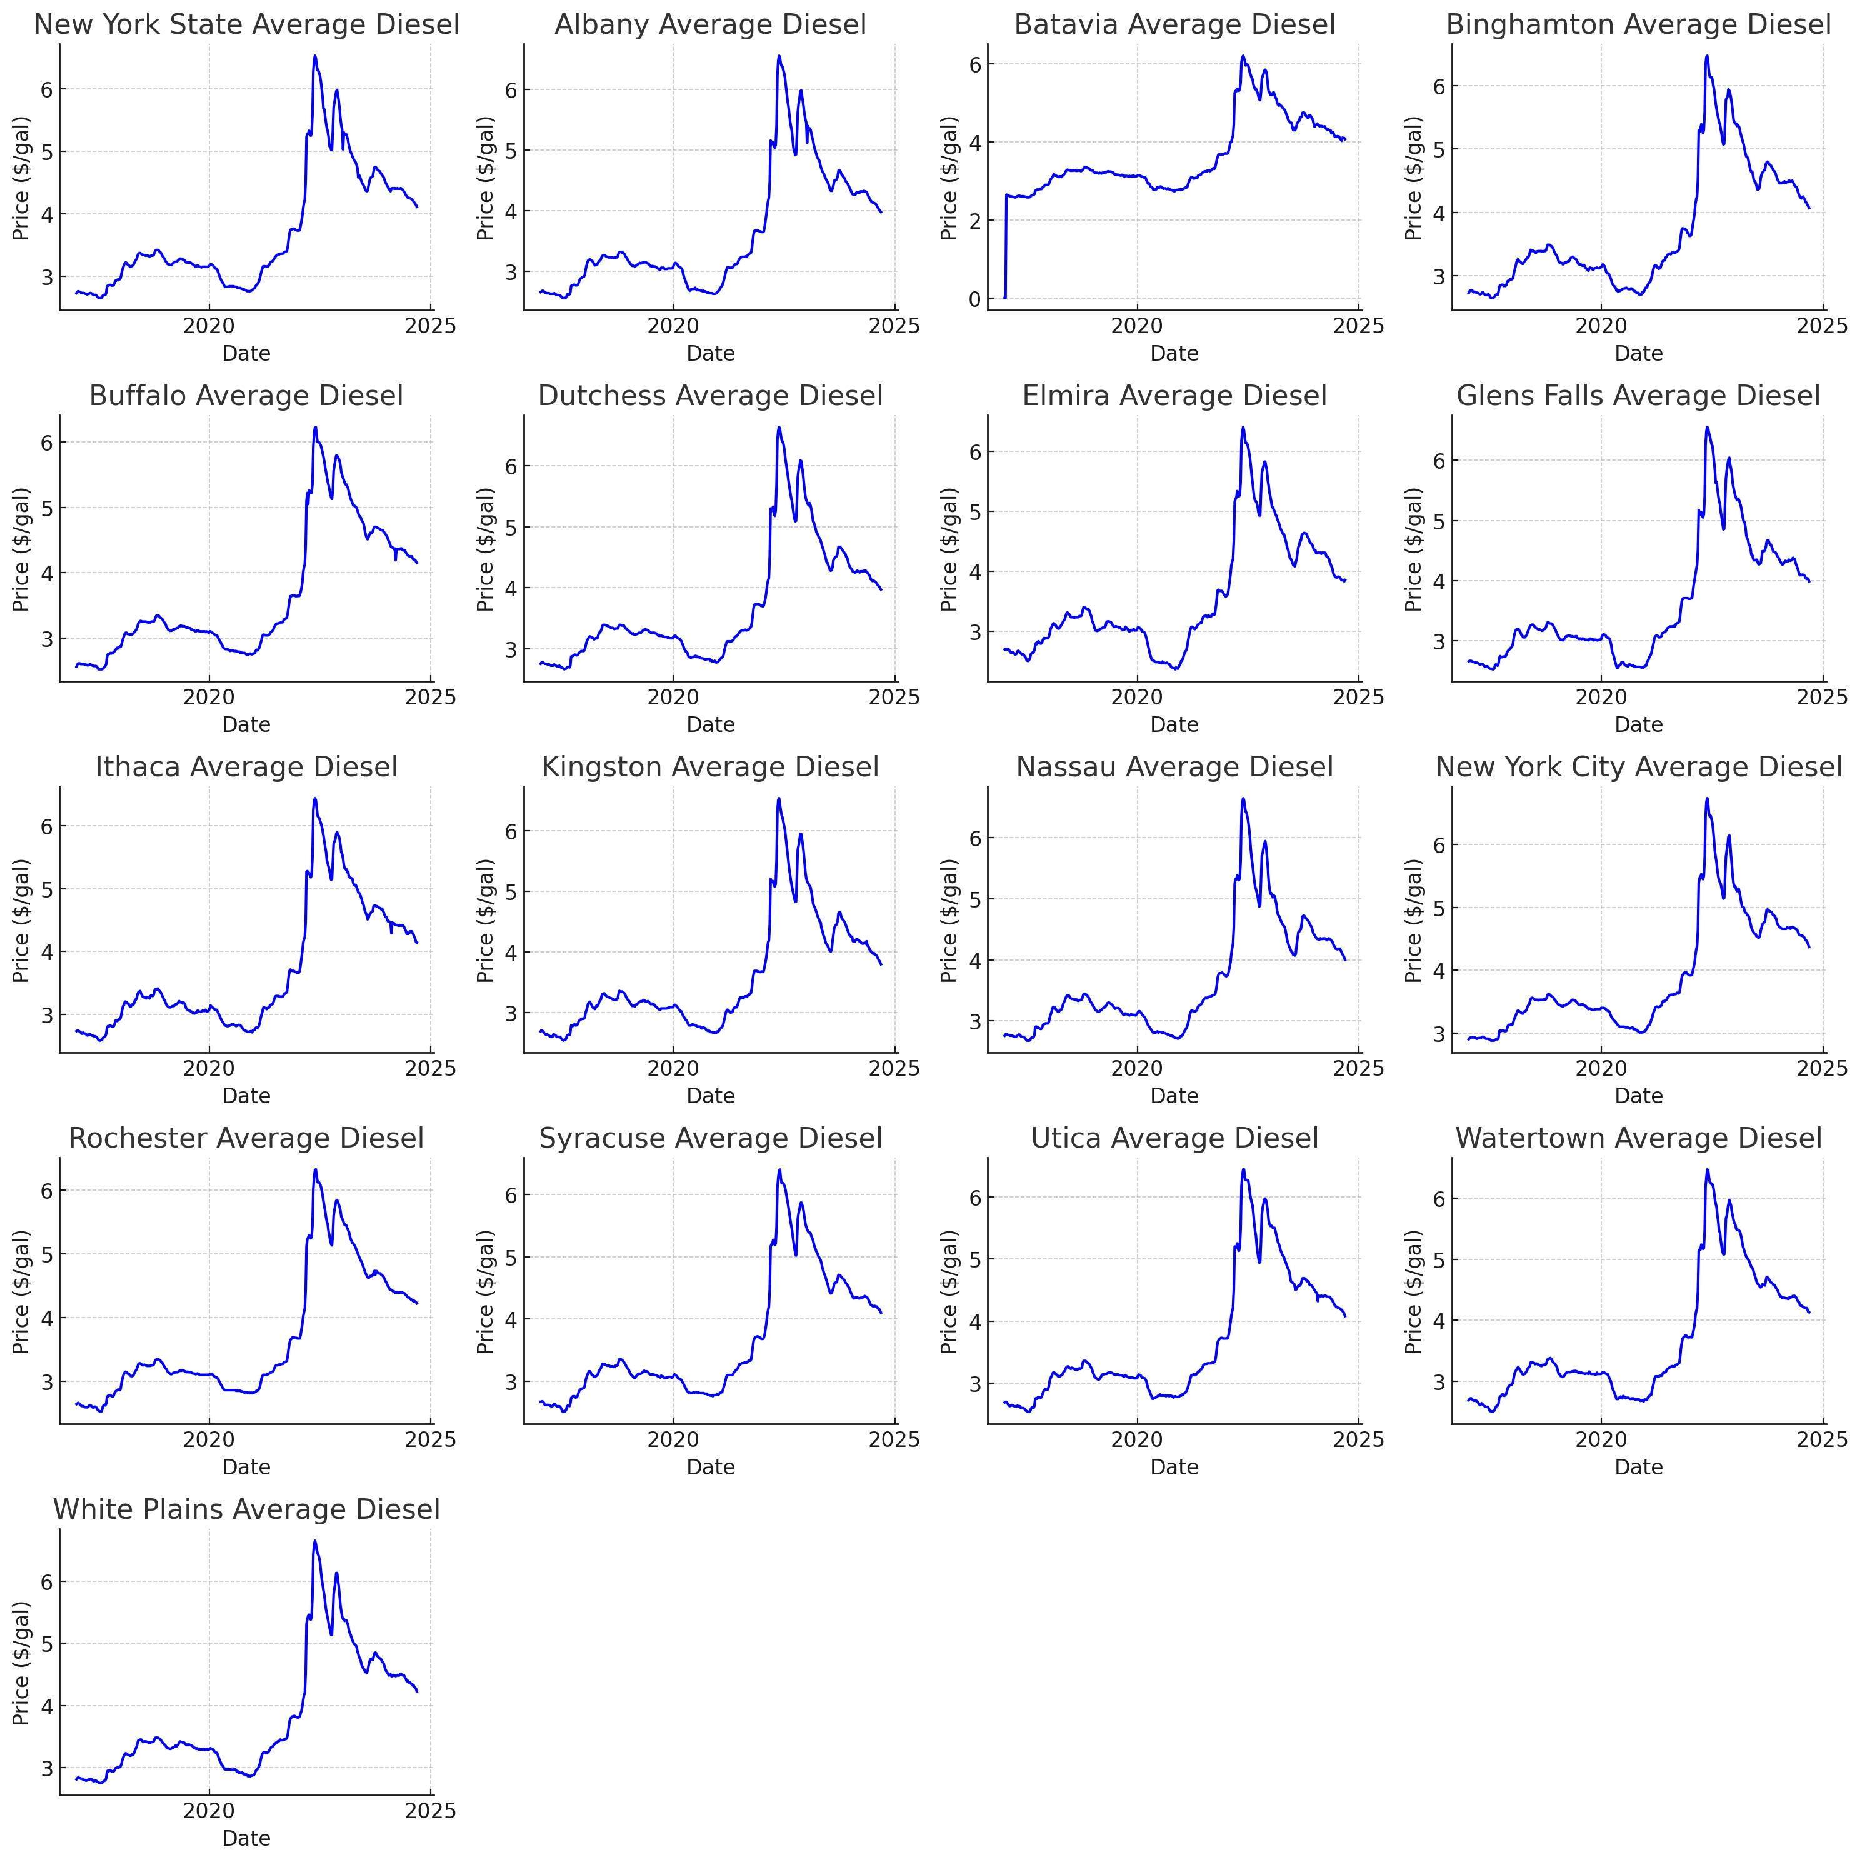
Data: NY Diesel Prices
Series all appear to be highly correlated.
Plots have similar shape as the gasoline price data, indicating possibly high correlation between this data and our response variable.
Will not be used in linear regression models.

Slide 11
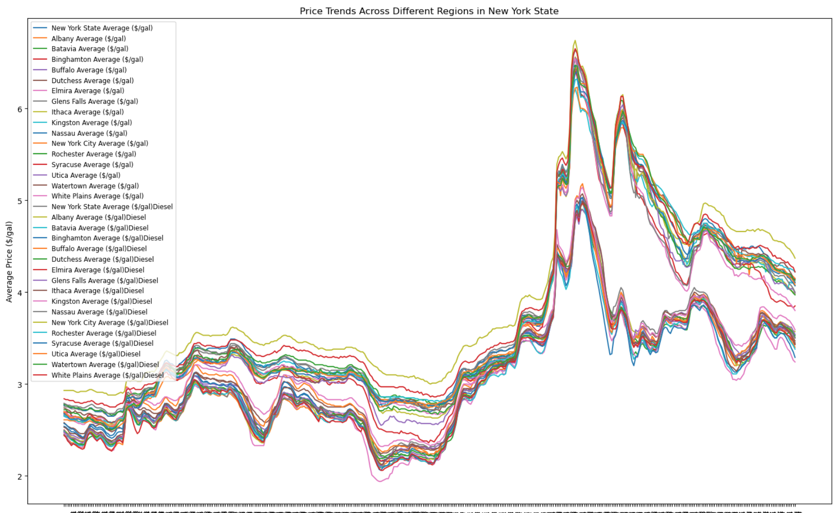

Slide 12
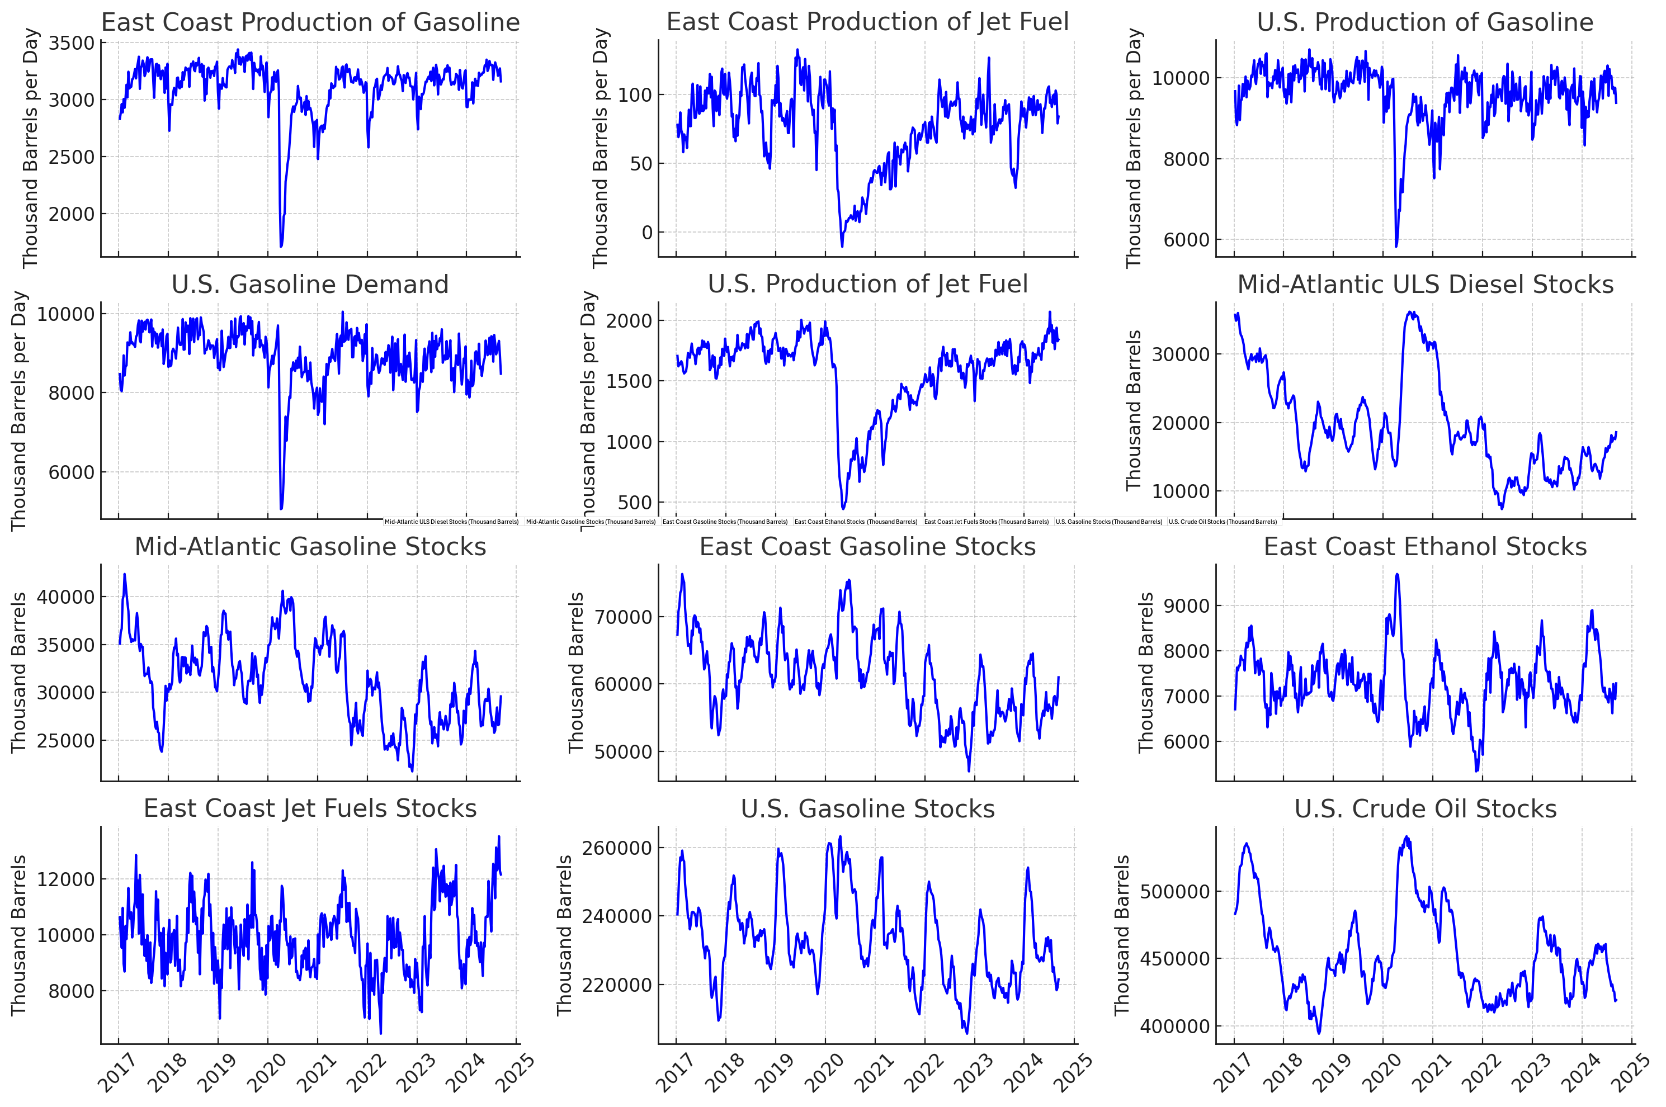
Data: Supply & Demand
Data does not appear as correlated with response variable.
Good candidates for independent variables in linear regression.

Slide 13
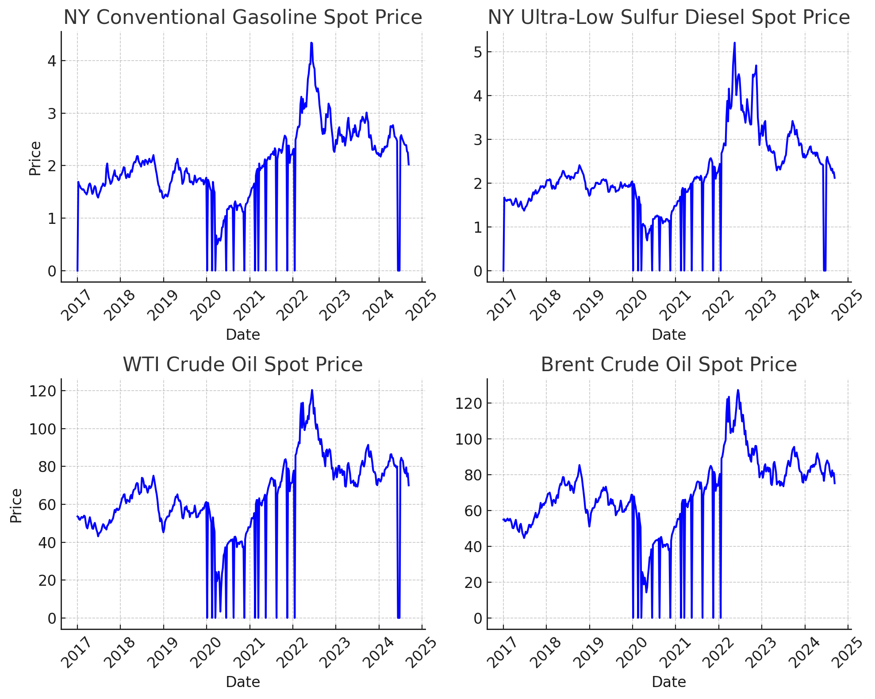
Data: Spot Prices
Data appear correlated (and similar to the NY gasoline and diesel data).
Missing data is causing the plots to fall to zero. This will be remedied before any analysis by forward filling prior data.

Slide 14
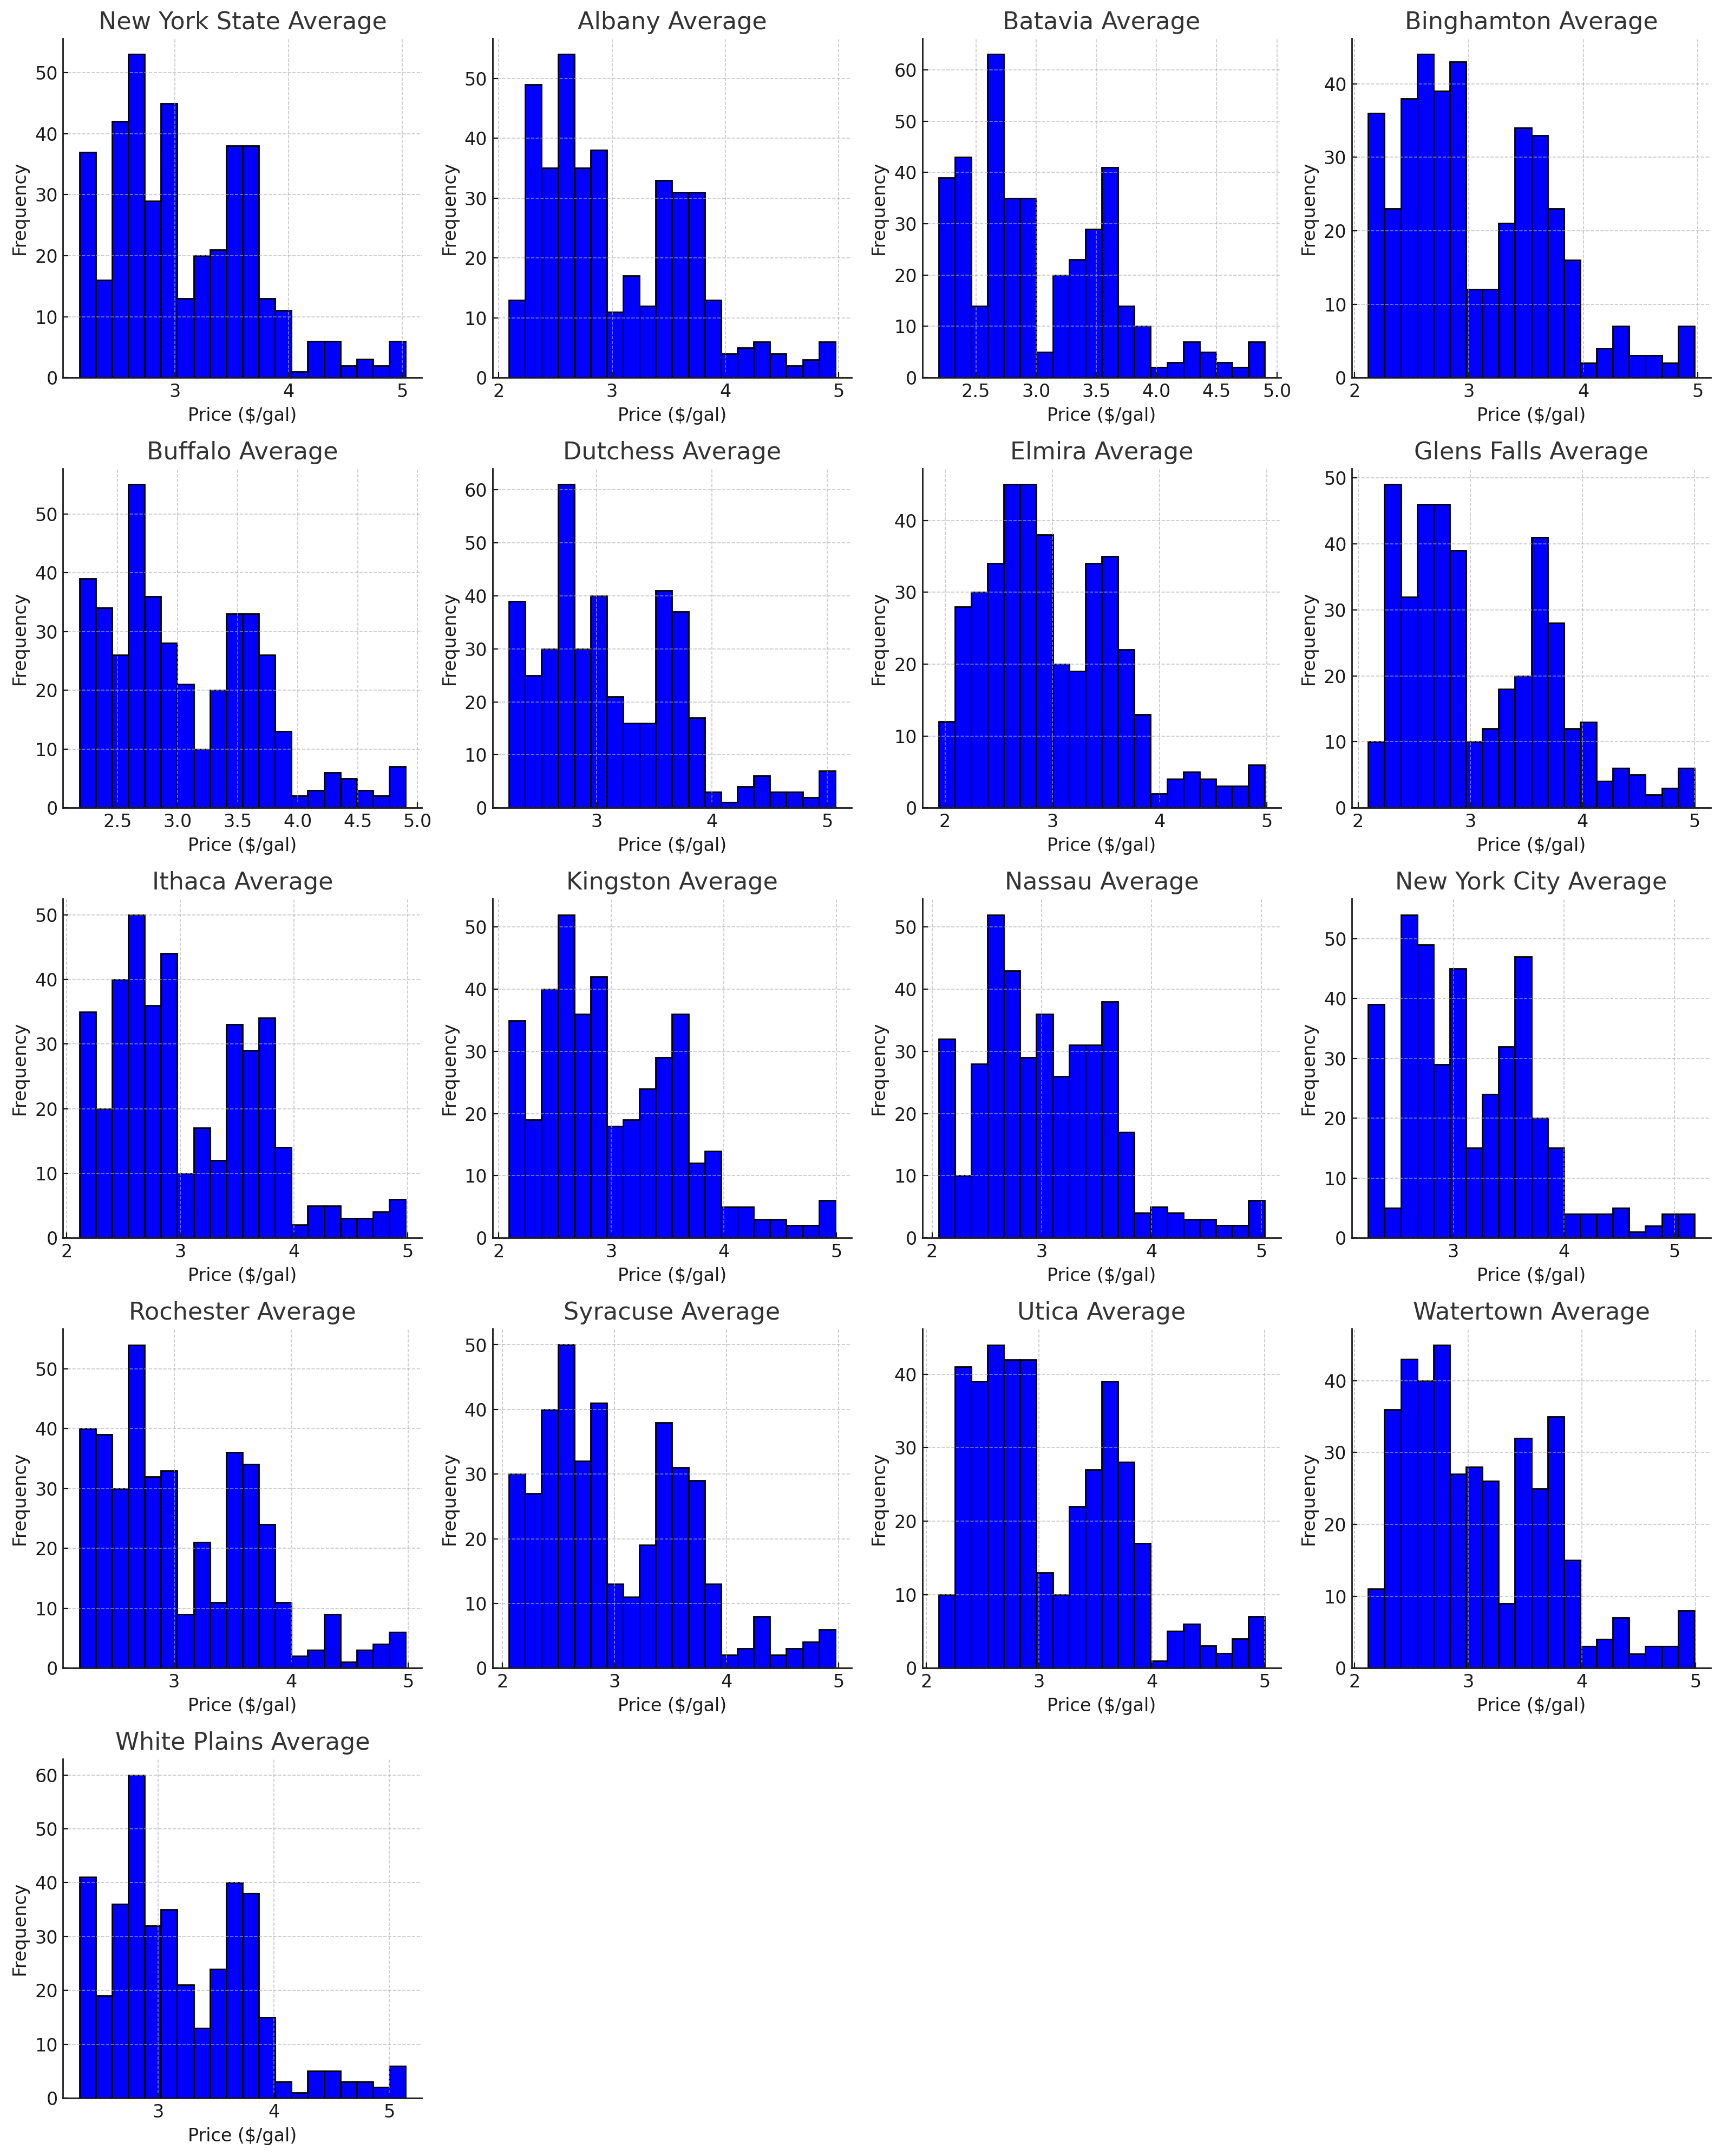
Data: NY Gas Price Histograms
Data have similar shape, which is expected given the line plots shown previously.
Most data appear bimodal.

Slide 15
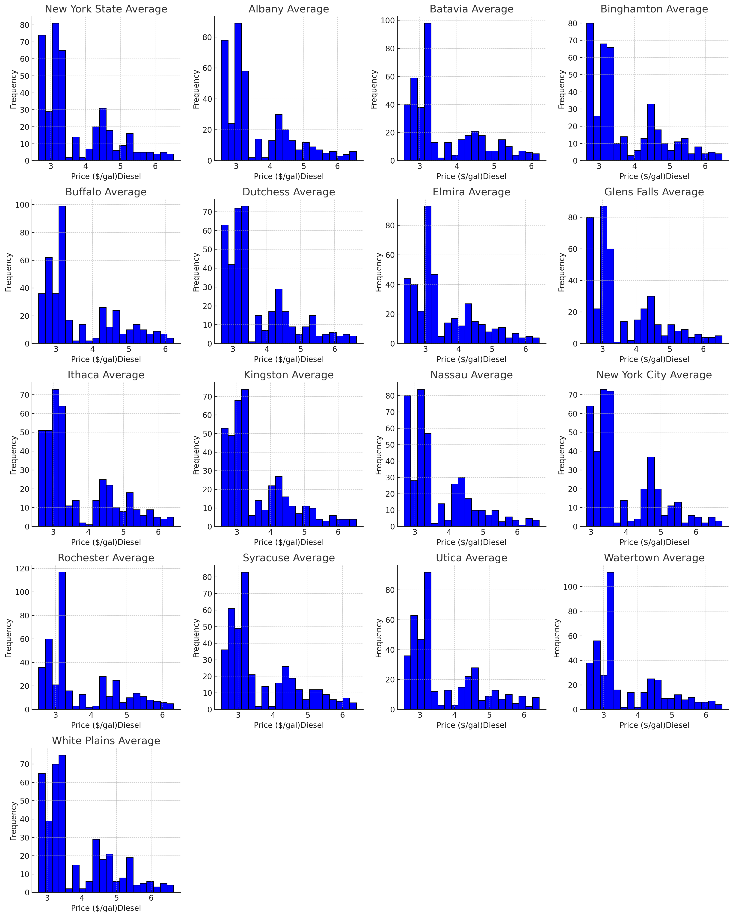
Data: NY Diesel Price Histograms
Similar histogram shapes follow logically from the similar time series data.
Data is clearly non-normally distributed, with much of the data in the far-left part of the distribution (right skew).
Data should be transformed prior to any regression analysis.

Slide 16
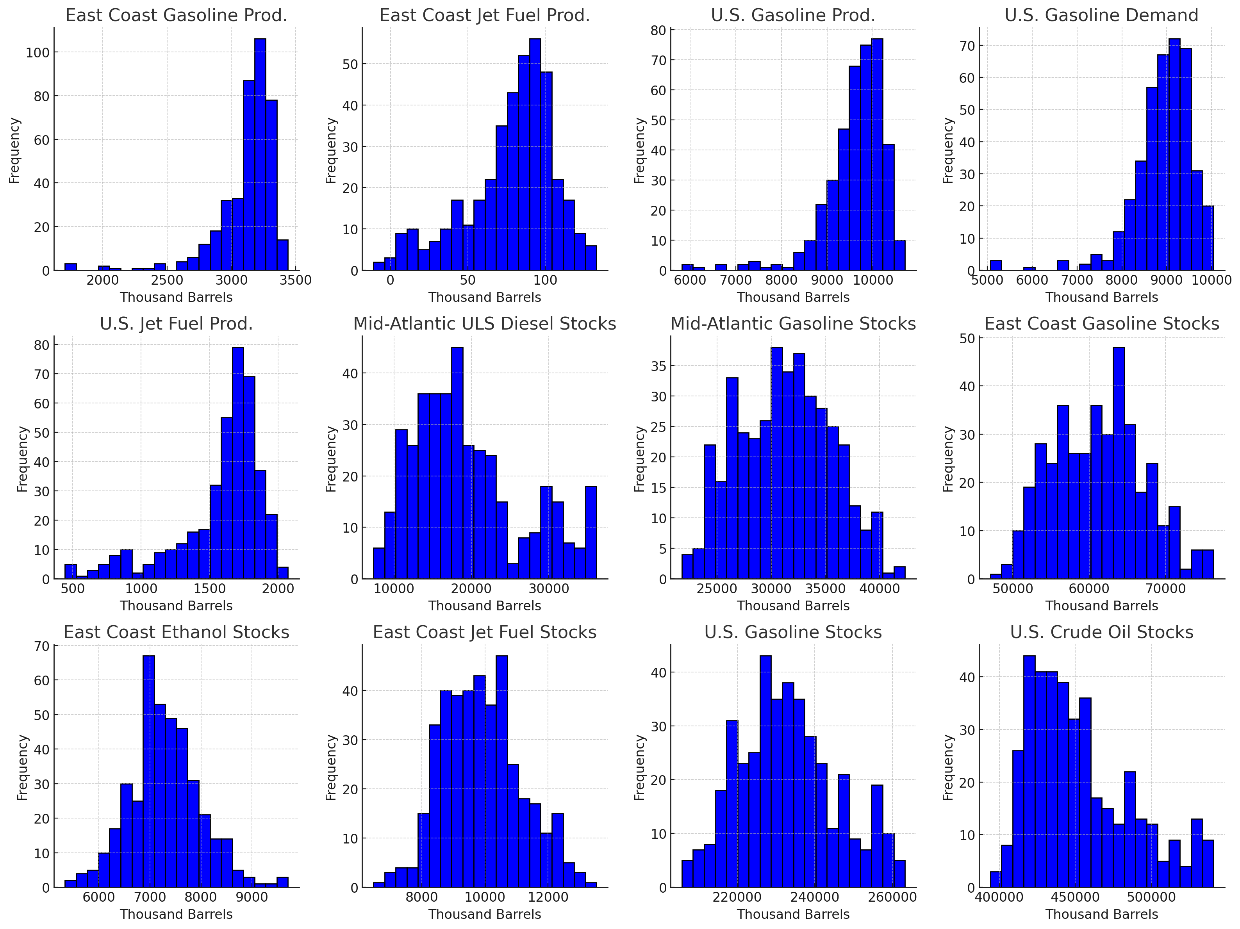
Data: Supply & Demand Histograms
Production and demand data show some left skew.
Other data are relatively normally distributed, and therefore likely won’t have to be transformed prior to any regression analysis.

Slide 17
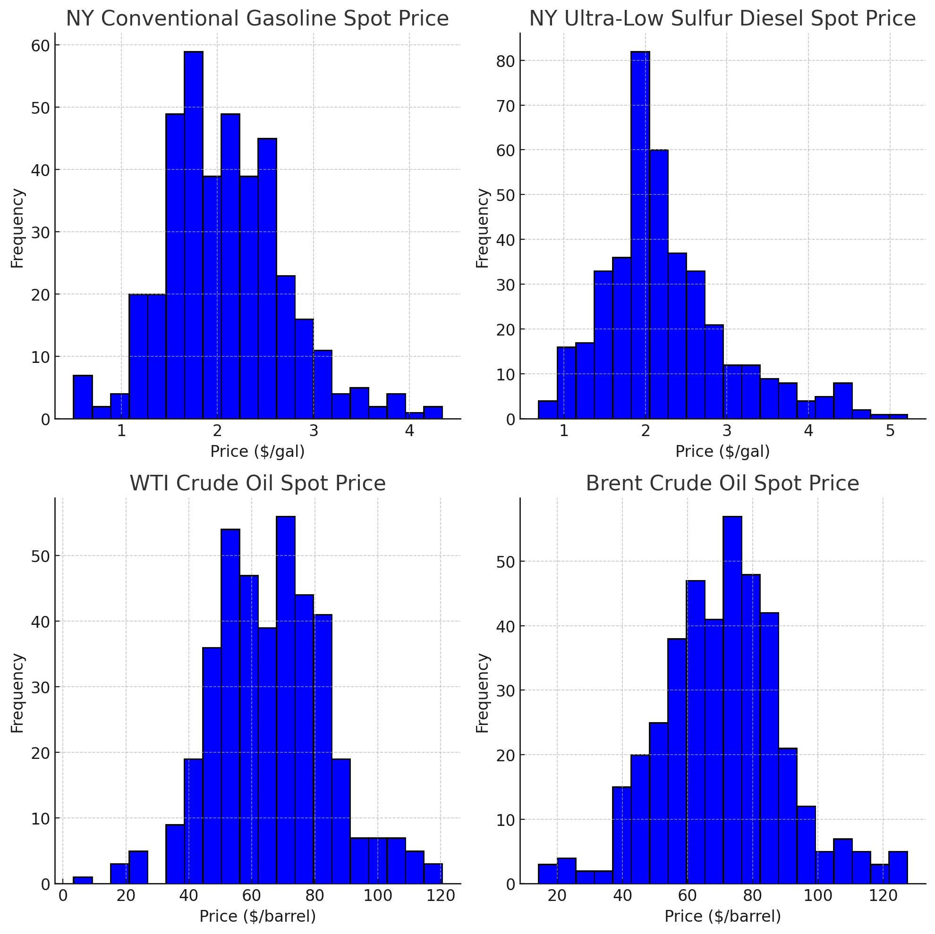
Data: Spot Price Histograms
Data series relatively normally distributed (note that the zero values have been accounted for here by forward-filling prior values).
Could be suitable candidates for regression analysis.

Slide 18
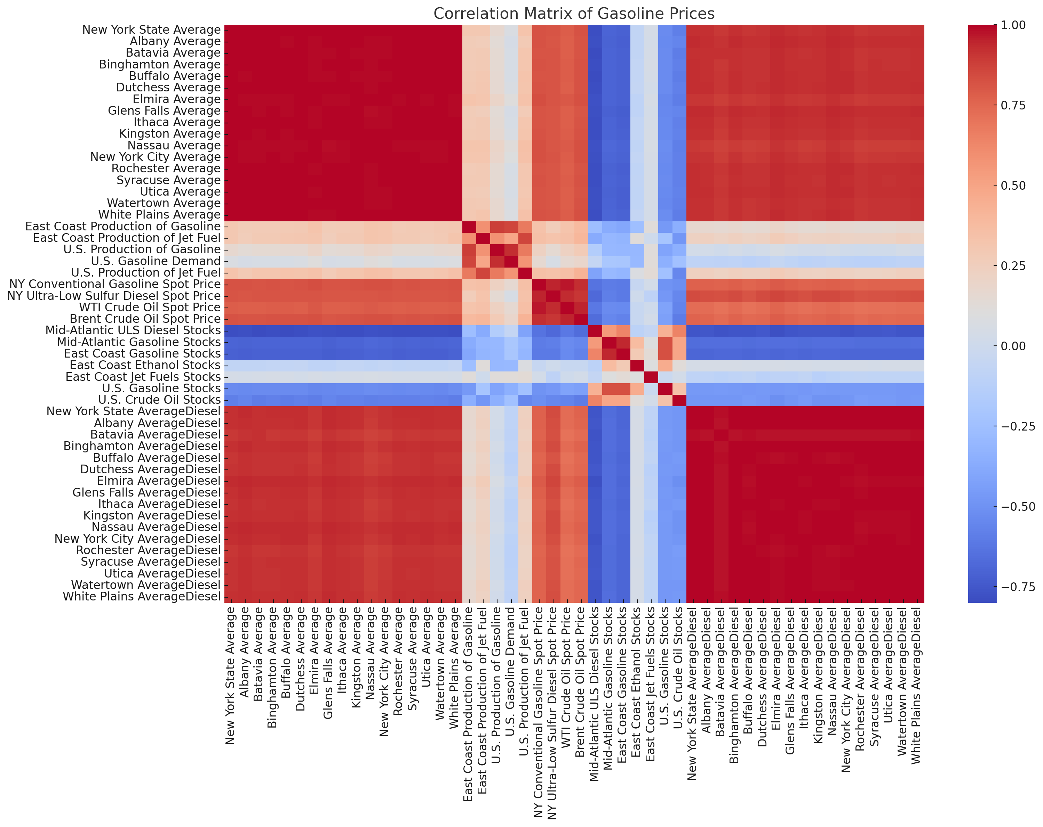
Data: Correlation Matrix
As expected, the gasoline and diesel data are highly correlated.
Negative correlation between Stocks (supply) and price of gasoline and diesel.
Weak correlation between US gasoline demand and gasoline prices.

Slide 19
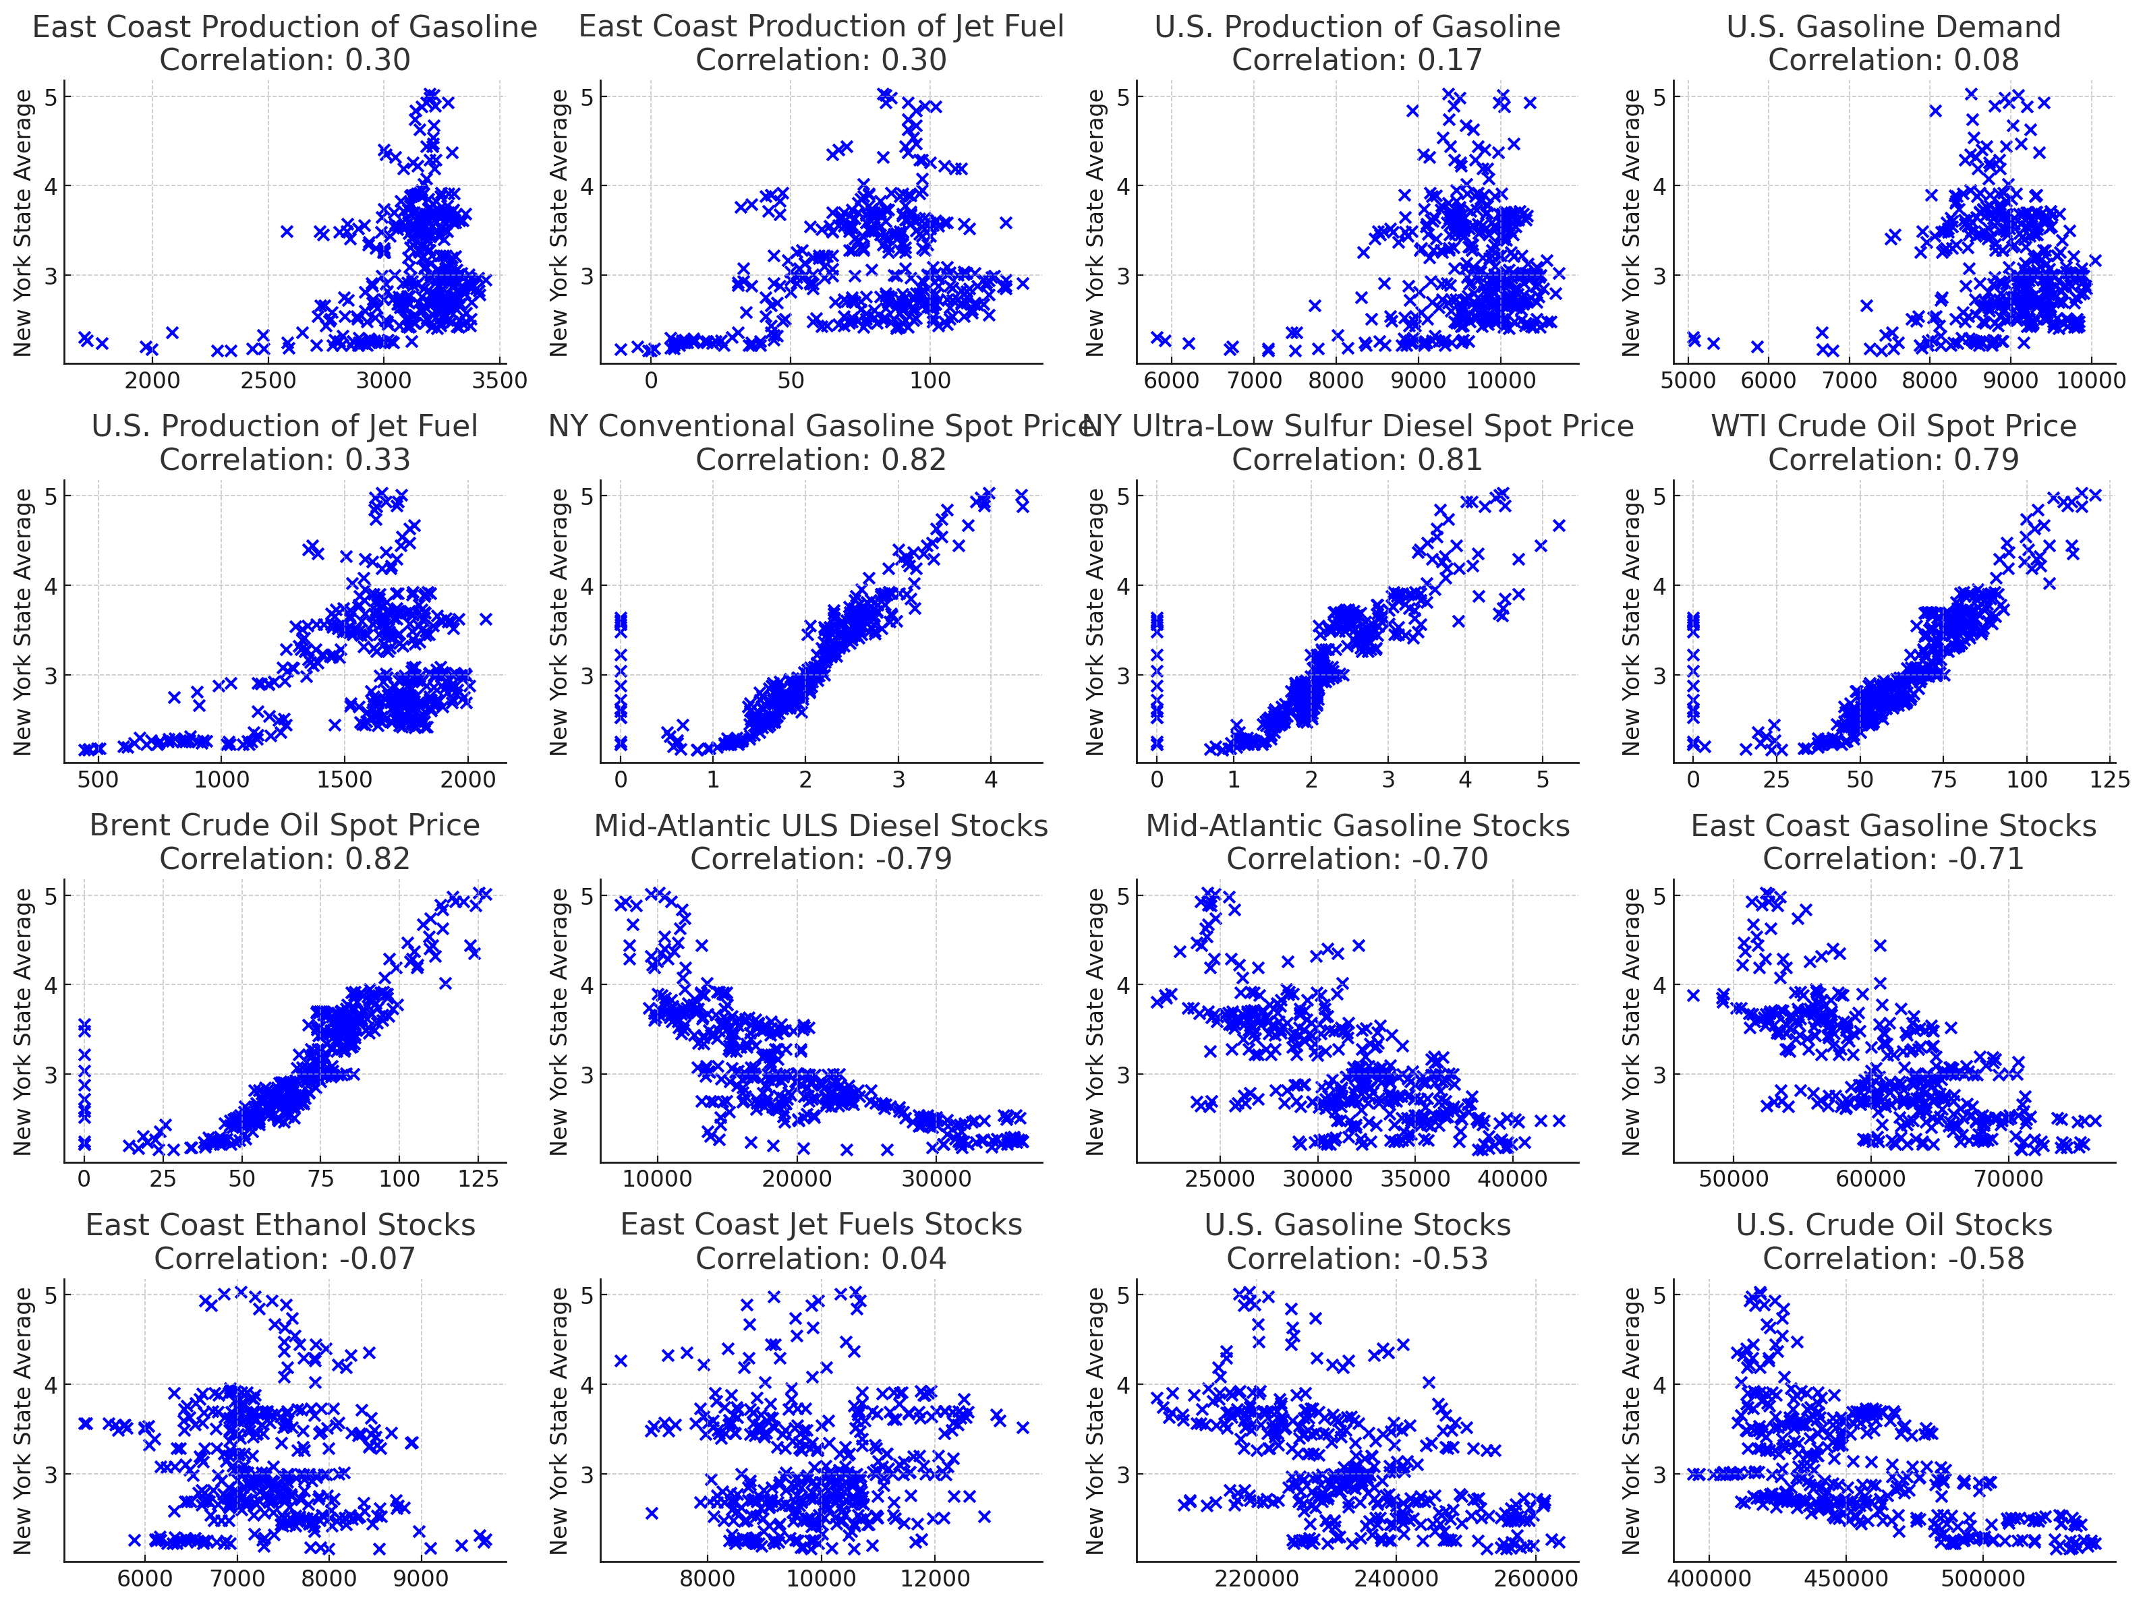
Data: Scatter Plots
Plot of response variable (New York State Average) versus various regressor variables with correlations.
Did not include other NY Average gasoline or NY Average diesel data due to high correlation.

Slide 20
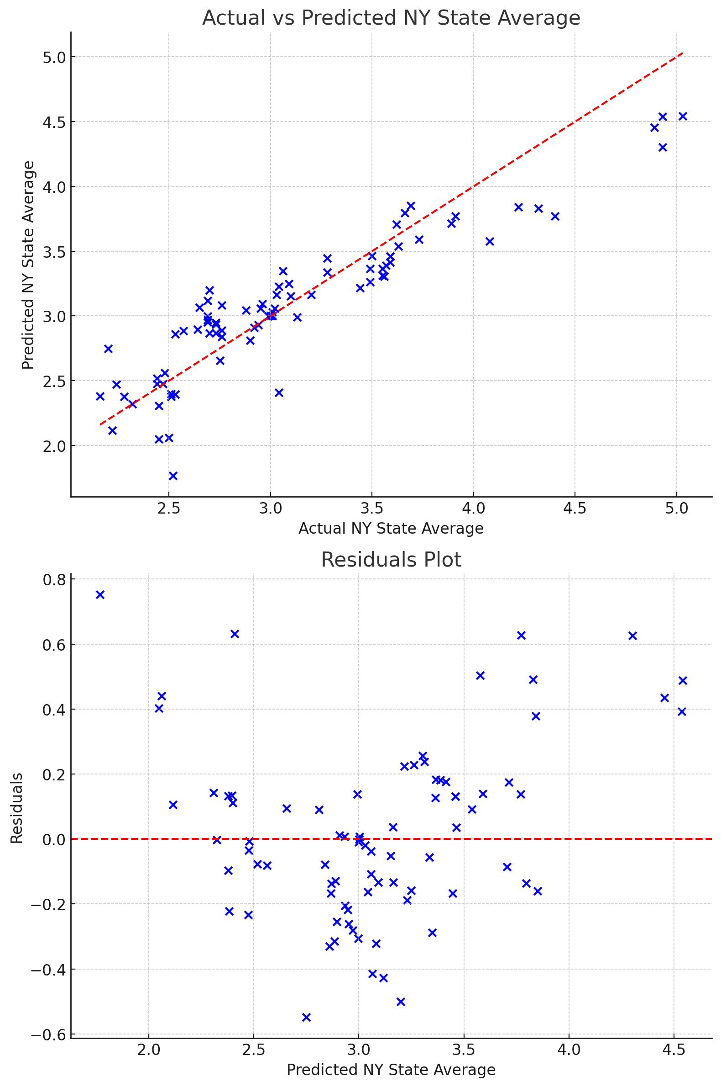
Results & Analysis: Linear Regression R² = 0.83 MSE = 0.0741 F-statistic = 117.54 (P-value = 0.000)
NY State Average = 1.9143***
+ 0.000355 * East Coast Production of Gasoline**
0.002672 * East Coast Production of Jet Fuel***
0.000072 * U.S. Production of Gasoline
0.000059 * U.S. Gasoline Demand
+ 0.000014 * U.S. Production of Jet Fuel
+ 0.696472 * NY Conventional Gasoline Spot Price***
0.006747 * NY Ultra-Low Sulfur Diesel Spot Price
0.021464 * WTI Crude Oil Spot Price***
+ 0.011432 * Brent Crude Oil Spot Price***
0.000030 * Mid-Atlantic ULS Diesel Stocks***
0.000049 * Mid-Atlantic Gasoline Stocks***
+ 0.000008 * East Coast Gasoline Stocks
0.000011 * East Coast Ethanol Stocks
+ 0.000013 * East Coast Jet Fuels Stocks
+ 0.000006 * U.S. Gasoline Stocks***
- 0.000002 * U.S. Crude Oil Stocks**

Slide 21
Results & Analysis: Variance Inflation Factor (VIF) Test
East Coast Production of Gasoline: 5.94
East Coast Production of Jet Fuel: 4.50
U.S. Production of Gasoline: 11.51
U.S. Gasoline Demand: 9.36
U.S. Production of Jet Fuel: 6.52
NY Conventional Gasoline Spot Price: 45.57
NY Ultra-Low Sulfur Diesel Spot Price: 15.43
WTI Crude Oil Spot Price: 51.15
Brent Crude Oil Spot Price: 15.37
Mid-Atlantic ULS Diesel Stocks: 3.93
Mid-Atlantic Gasoline Stocks: 11.14
East Coast Gasoline Stocks: 13.11
East Coast Ethanol Stocks: 2.20
East Coast Jet Fuels Stocks: 1.64
U.S. Gasoline Stocks: 5.20
U.S. Crude Oil Stocks: 3.05
Value greater than 10 indicates high multicollinearity

Slide 22
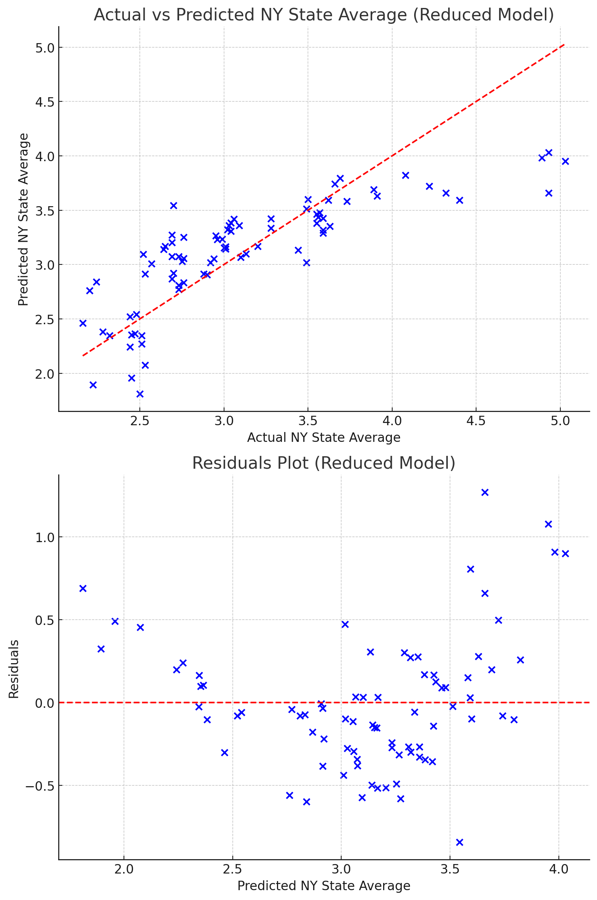
Results & Analysis: Linear Regression R² = 0.64 MSE = 0.158 F-statistic = 82.51 (P-value = 0.000)
NY State Average = 7.607***
+ 0.000660* East Coast Production of Gasoline***
+ 0.000863 * East Coast Production of Jet Fuel
0.000224 * U.S. Gasoline Demand***
- 0.000221 * U.S. Production of Jet Fuel
0.000051 * Mid-Atlantic ULS Diesel Stocks***
0.000025 * East Coast Ethanol Stocks
+ 0.000020 * East Coast Jet Fuels Stocks
- 0.000009 * U.S. Gasoline Stocks***
- 0.000003 * U.S. Crude Oil Stocks**

Slide 23
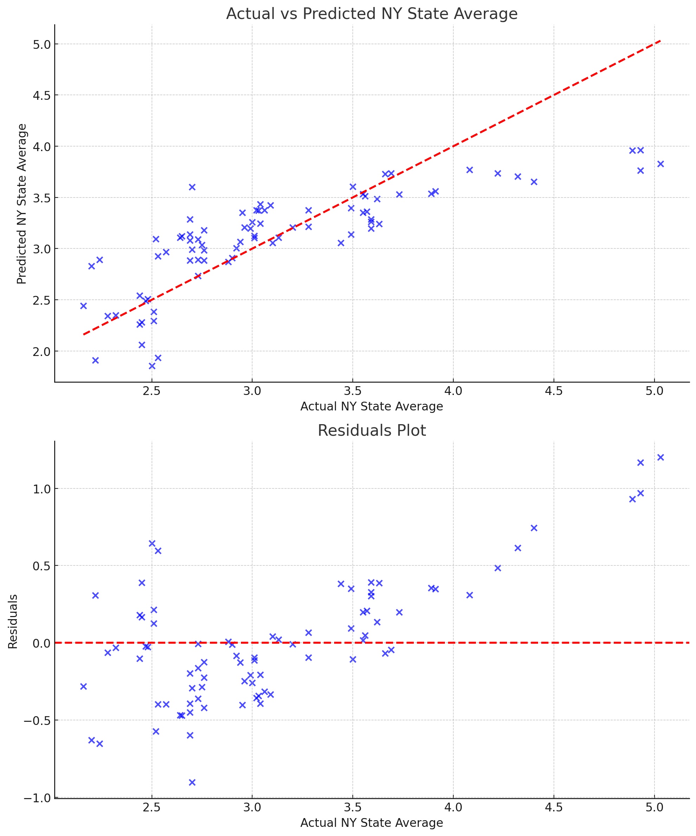
Results & Analysis: Stepwise Regression R² = 0.689 MSE = 0.165 F-statistic = 175.2 (P-value = 0.000)
NY State Average = 7.8924***
- 0.0001 * U.S. Production of Jet Fuel*
5.48x10⁻⁵ * Mid-Atlantic ULS Diesel Stocks***
- 1.06x10⁻⁵ * U.S. Gasoline Stocks***
- 2.34x10⁻⁶ * U.S. Crude Oil Stocks***

Slide 24
Conclusions
Small Direct Effects:
The low magnitude of the coefficients indicates that while statistically significant, the explanatory variables (e.g., stocks and production levels) have small direct impacts on the New York State Average gasoline price.
Potential Multicollinearity:
Despite removing high-VIF variables, there could still be some residual multicollinearity, which could limit the effectiveness of the remaining features.
Possible Nonlinear Dynamics:
Gasoline prices may be influenced by nonlinear relationships, market dynamics, or interactions between the explanatory variables, which are not fully captured by the linear regression model.
Need for Additional Variables:
Factors beyond fuel stocks and production, such as macroeconomic indicators or external events, likely contribute to the price fluctuations and could enhance model accuracy if included.

Slide 25
Further Research
Nonlinear Models:
Apply Random Forests or Gradient Boosting to capture nonlinear relationships between fuel stocks, production, and prices.
Use Support Vector Machines (SVMs) with nonlinear kernels to explore complex interactions between variables.
Feature Engineering:
Incorporate interaction terms to capture potential relationships between stocks and production levels.
Introduce lagged variables to account for the delayed impact of stocks and production on gasoline prices.
Regularization Methods:
Implement Lasso or Ridge Regression to address multicollinearity and reduce the influence of less important features.
Ensemble Learning:
Combine multiple models (e.g., linear regression, decision trees) using Stacking or Blending to improve prediction accuracy.
Data Augmentation and Cross-Validation:
Integrate macroeconomic variables (e.g., inflation, unemployment) and weather data to enhance feature richness.
Apply k-fold cross-validation to ensure the robustness and generalization of the model across different subsets of the data.

